Slide 1

Simple Linear Regression is a type of Regression algorithms that models the relationship between a dependent variable and a single independent variable. The relationship shown by a Simple Linear Regression model is linear or a sloped straight line, hence it is called Simple Linear Regression.
The key point in Simple Linear Regression is that the dependent variable must be a continuous/real value. However, the independent variable can be measured on continuous or categorical values.

Slide 2
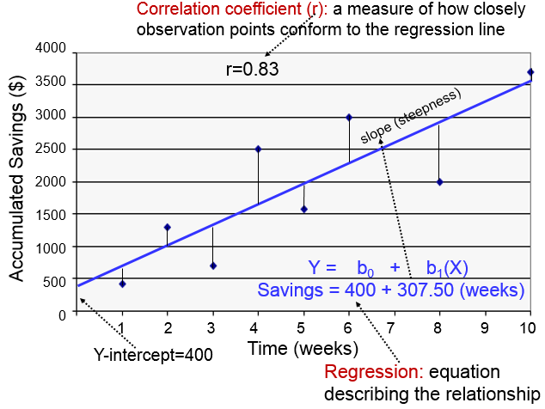

Slide 3


Slide 4
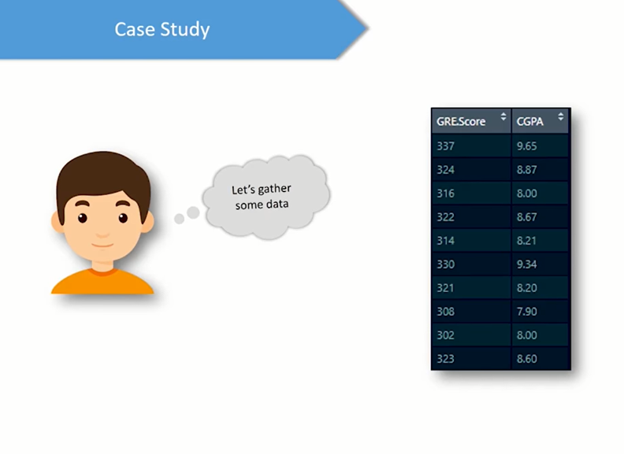

Slide 5
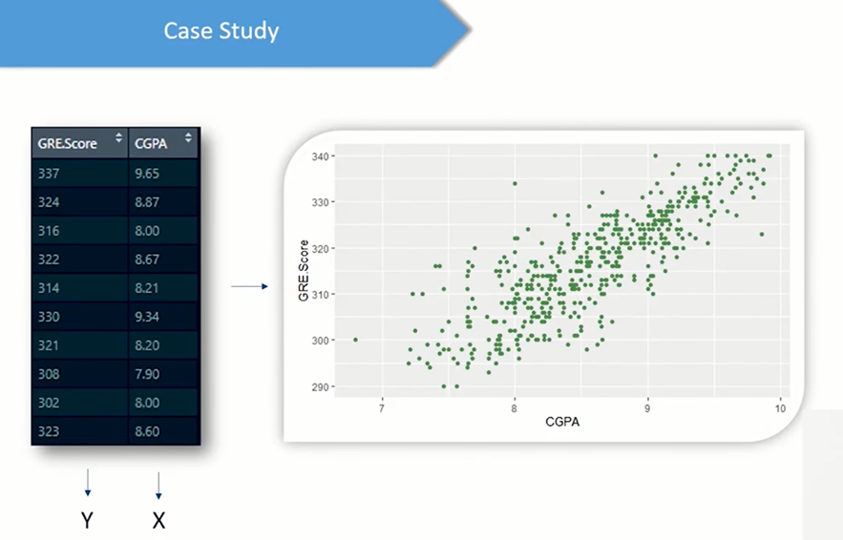

Slide 6
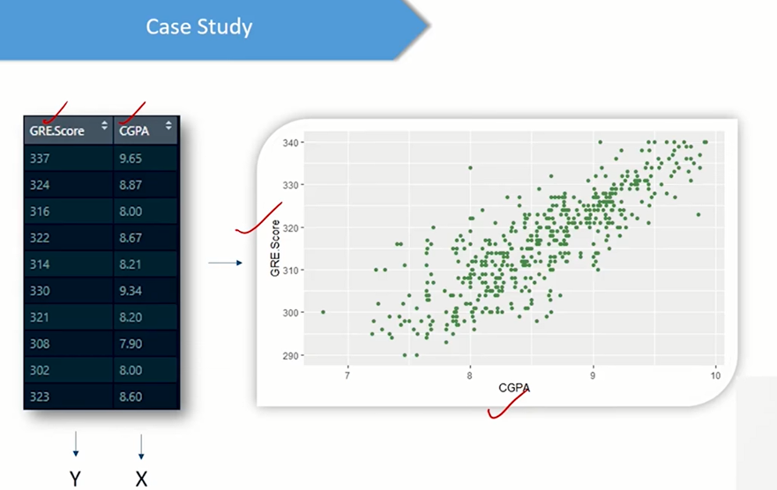

Slide 7
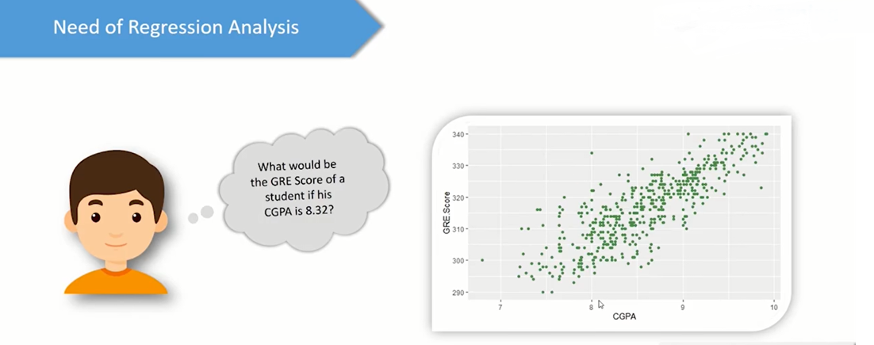

Slide 8
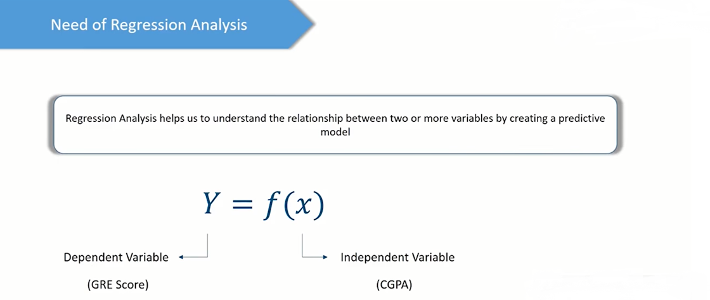

Slide 9
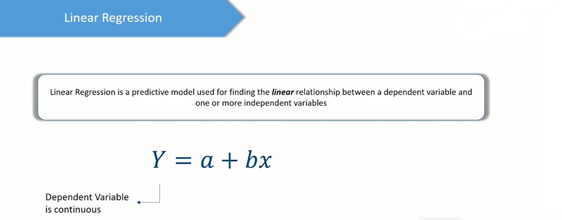

Slide 10
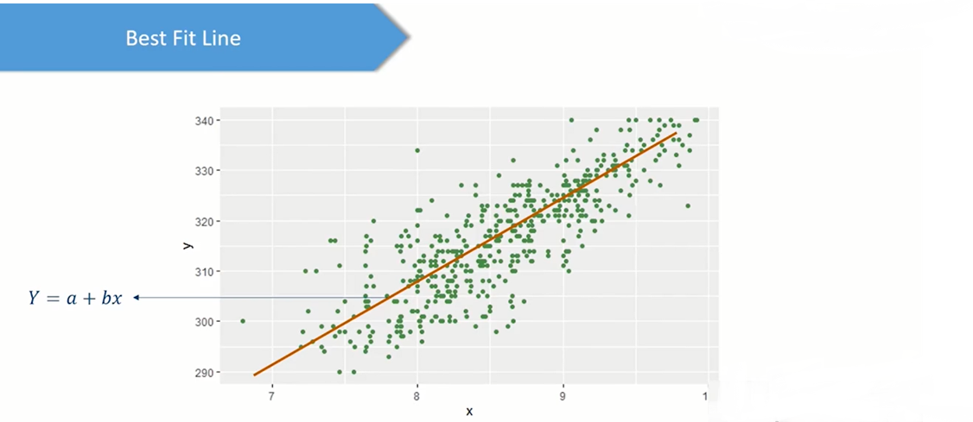

Slide 11
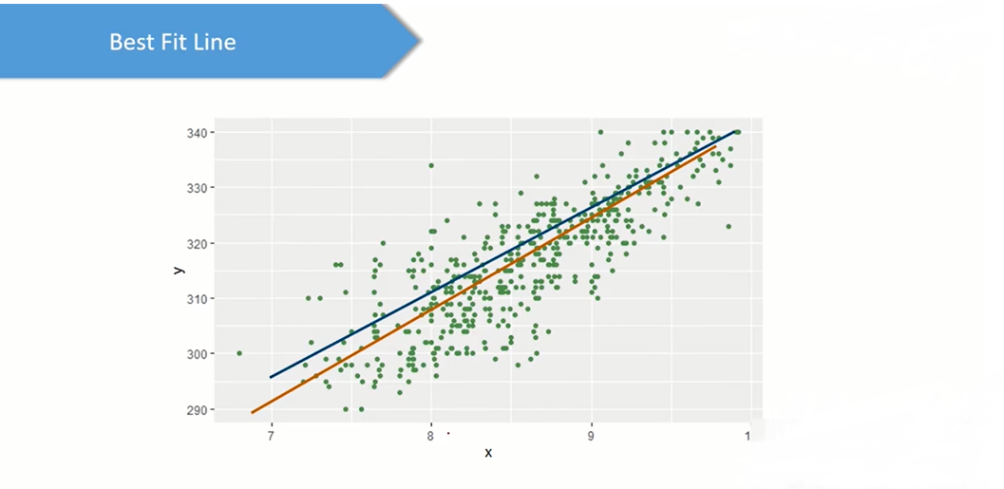

Slide 12
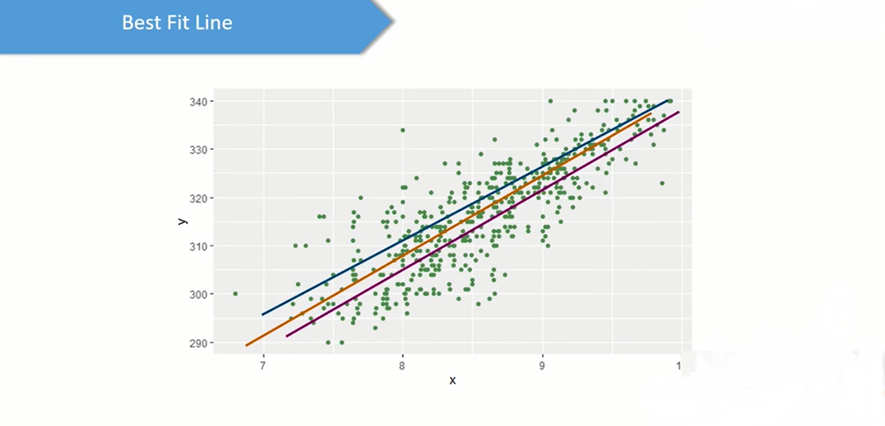

Slide 13
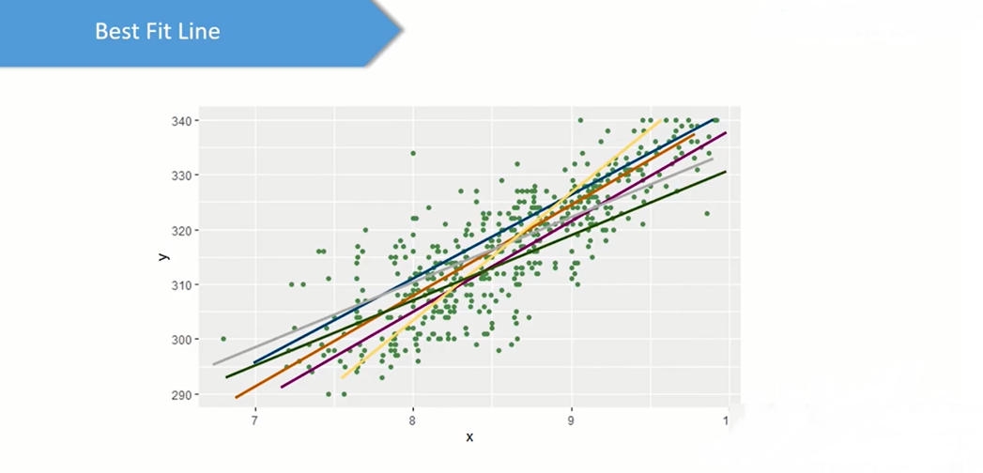

Slide 14
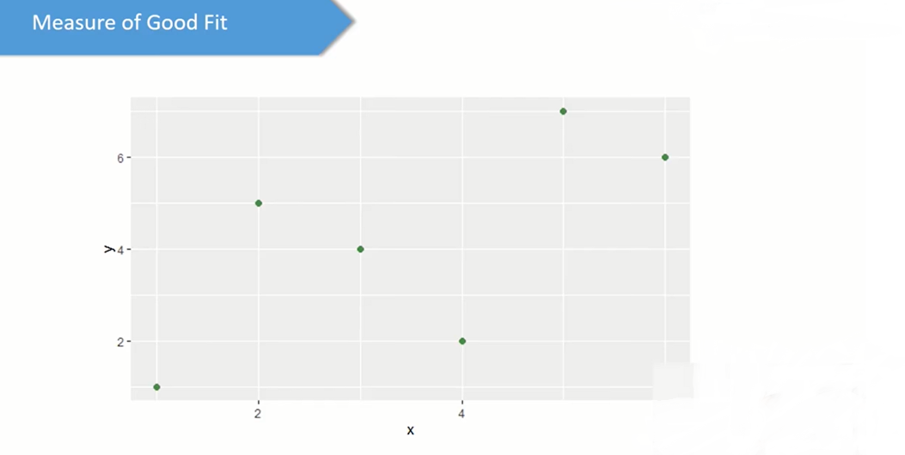

Slide 15
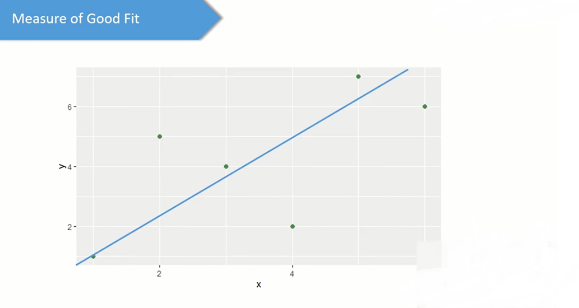

Slide 16
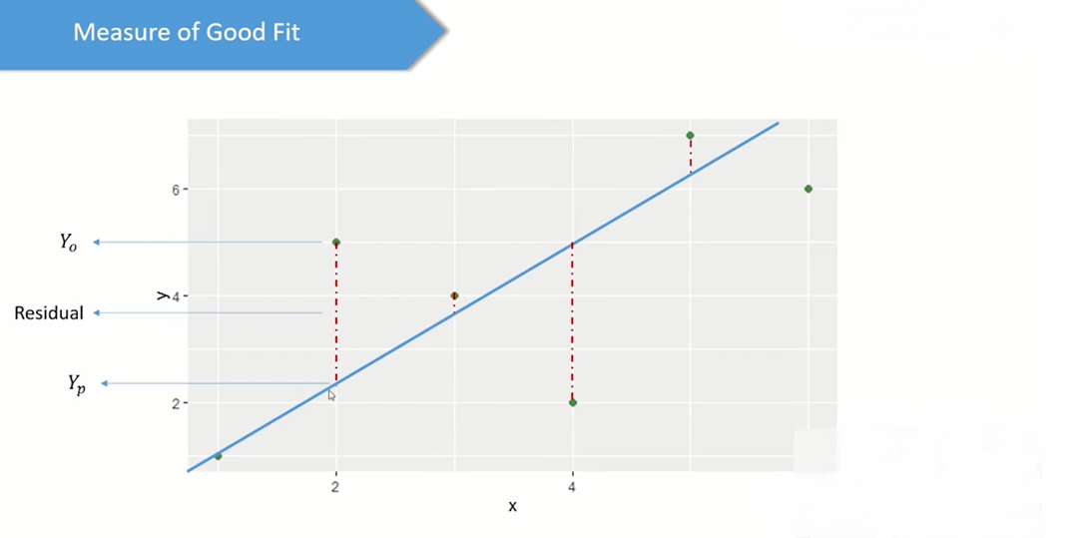

Slide 17
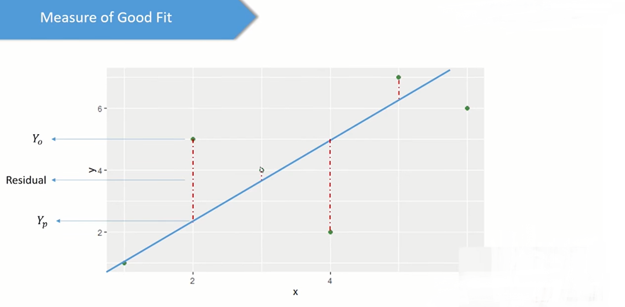

Slide 18
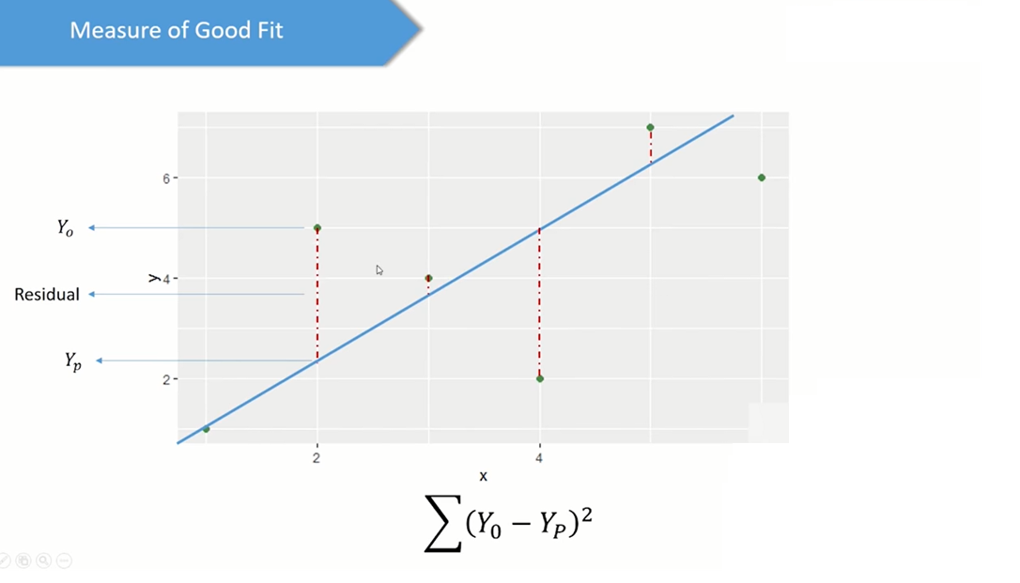

Slide 19
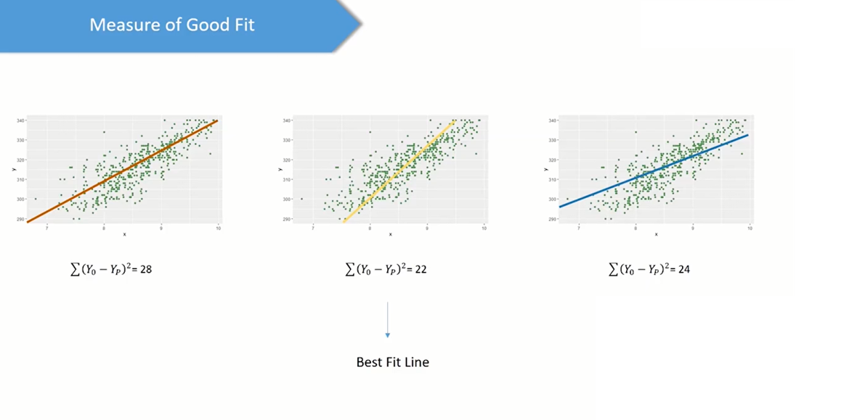

Slide 20
